Slide 1
Automatic Dustbin
Participants:
ME22B108 Arya Bhandarkar
ME22B097 Advait Jog
ME22B090 Aaryan Bharti
ME22B104 Aniket Singh
ME22B098 Adwitiya Goyal
ME22B091 Aayush Malaviya
Group 5

Slide 2
Introduction :
The Automatic Dustbin project is motivated by the increasing need for efficient waste management solutions in both domestic and public settings. By integrating sensor-based technology, this project seeks to mitigate these challenges by enabling automatic lid operationand waste level detection.

Slide 3
Aim :
Efficiently managing waste with our automatic dustbin project, simplifying disposal in homes and public areas.
Objective :
Design and implement an innovative automatic dustbin system equipped with sensors to detect waste overflow, monitor waste levels, and facilitate seamless waste disposal, contributing to enhanced cleanliness and efficiency in both residential and commercial settings.

Slide 4
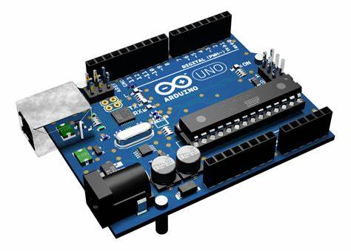
Micro-controller :

Slide 5
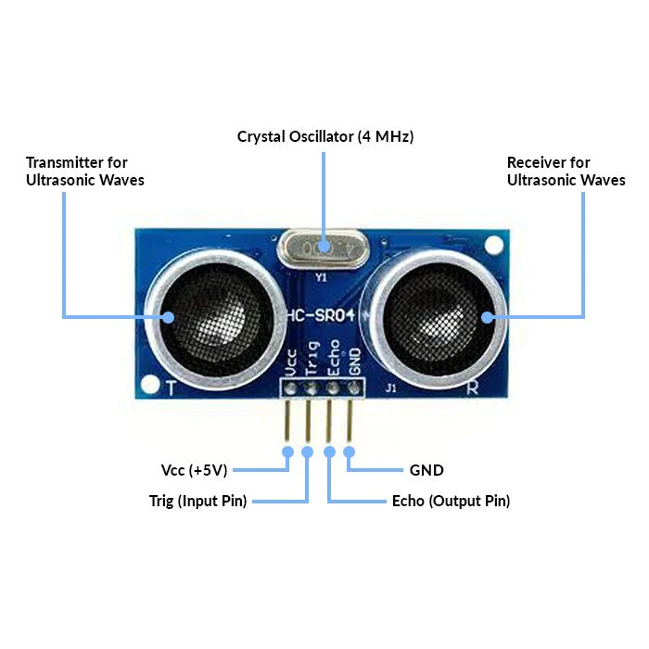
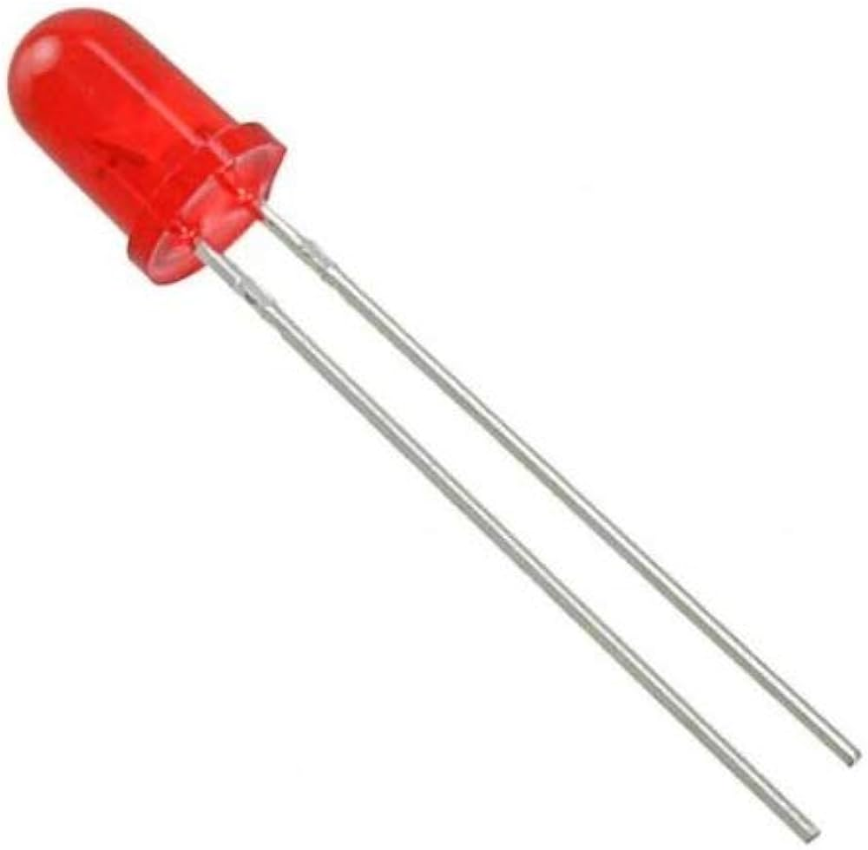
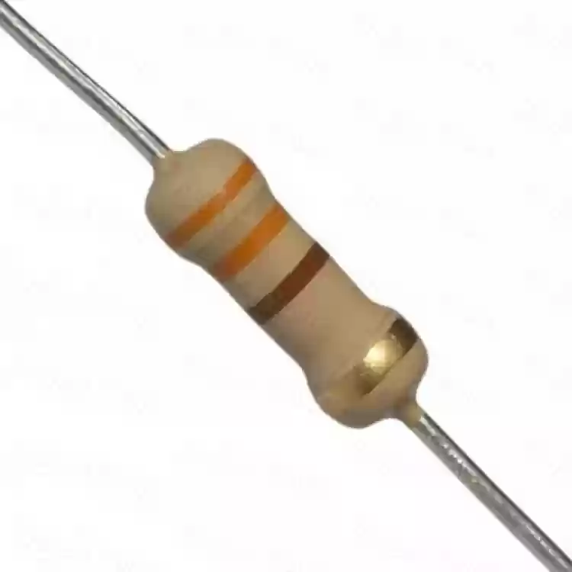
Module 1: Garbage Level Detection
Components used:
Ultrasonic Sensor
LED (Light Emitting Diode)
Resistor
Specifications:
-LED Specifications:
Color: Red
Operating voltage: ~9 V
Temperature range: -40°C to 85°C
°

Slide 6
-Ultrasonic Sensor:
2 cm to long-range 4 m detection and ranging
Level output: high-5V
Static current: < 2mA
Frequency: 40 KHz
High-density and Small blind distance
Temperature range: -20°C to 70°C
-Resistor Specifications:
Resistance: 330 Ω
Power rating: 0.25 W

Slide 7
Working Principle
The working principle of an ultrasonic sensor involves the emission of ultrasonic waves and the measurement of the time it takes for these waves to reflect off an object and return to the sensor.
Generation of Ultrasonic Waves: The sensor consists of a transducer that can convert electrical energy into ultrasonic sound waves.
Reflection of Ultrasonic Waves: When the ultrasonic waves encounter an object in their path, they are reflected back towards the sensor due to the difference in acoustic impedance between air and the object.
Reception of Reflected Waves: The sensor's receiver detects the reflected ultrasonic waves.

Slide 8
Measurement of Time Delay: The sensor measures the time delay between the emission of the ultrasonic waves and the reception of their reflection.
Output: The calculated distance is then provided as output, typically in the form of an analog voltage, digital pulse, or serial communication signal, depending on the sensor's design.

Slide 9
Functionality
Distance Measurement: The main function of an ultrasonic sensor is to accurately measure the distance between the sensor and an object in its field of view.
Non-Contact Sensing: Ultrasonic sensors operate without physical contact with the object being measured.
Accuracy and Precision: Ultrasonic sensors are designed to provide accurate and precise distance measurements within their specified range.

Slide 10
Range Detection: Ultrasonic sensors can detect objects within a specified range, which can vary from a few centimeters to several meters depending on the sensor model.
Presence Detection: Ultrasonic sensors can also be used to detect the presence or absence of objects within their detection range.

Slide 11
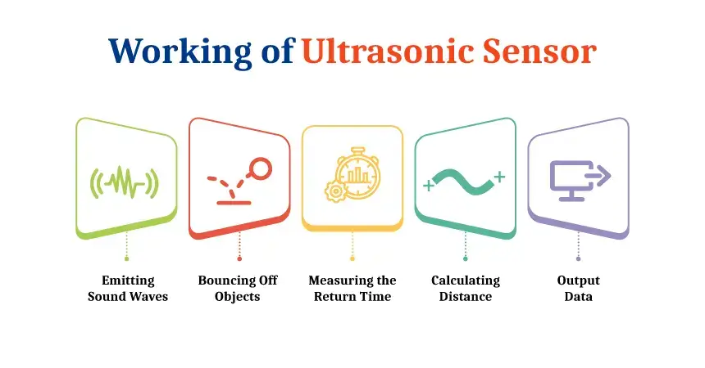
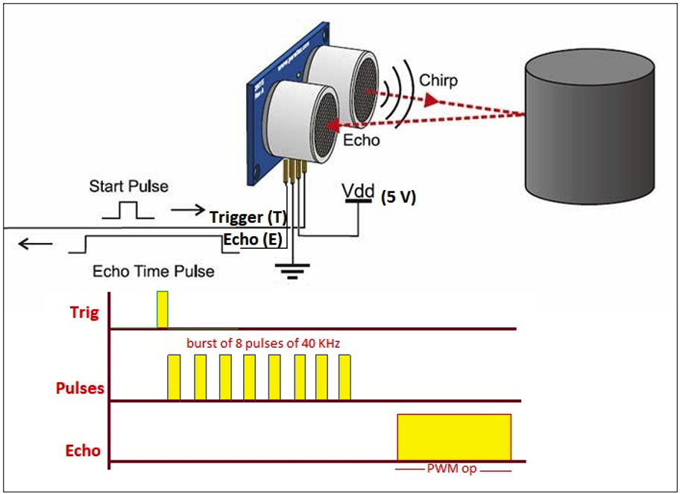
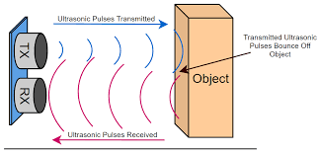

Slide 12
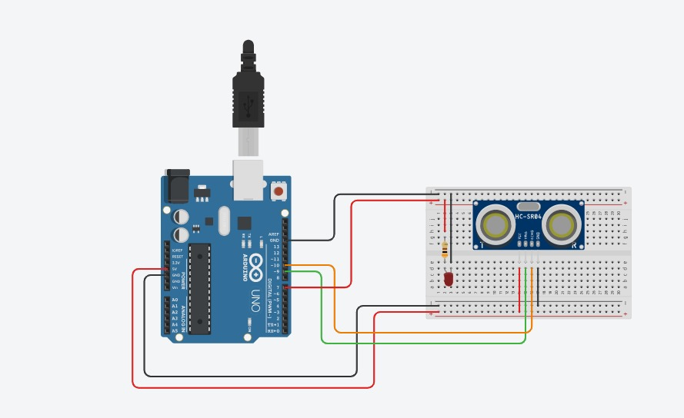
Connections

Slide 13
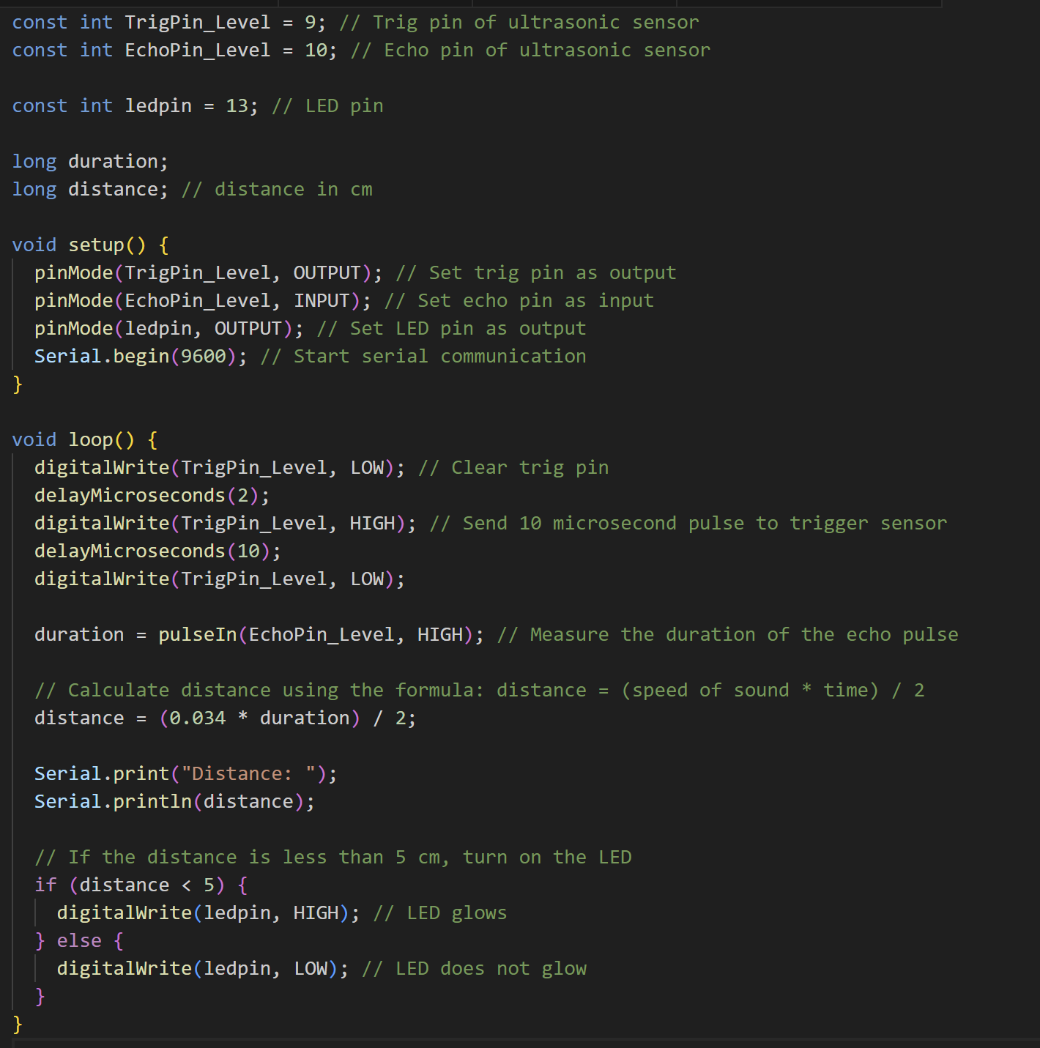
Programming

Slide 14
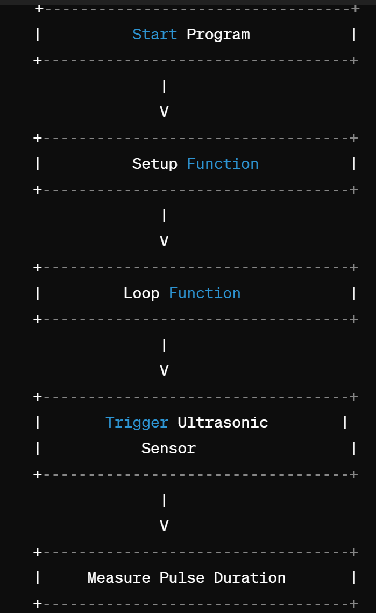
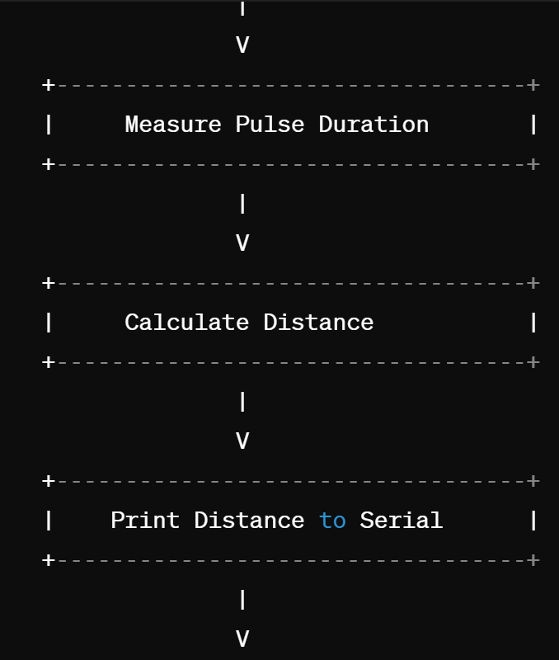
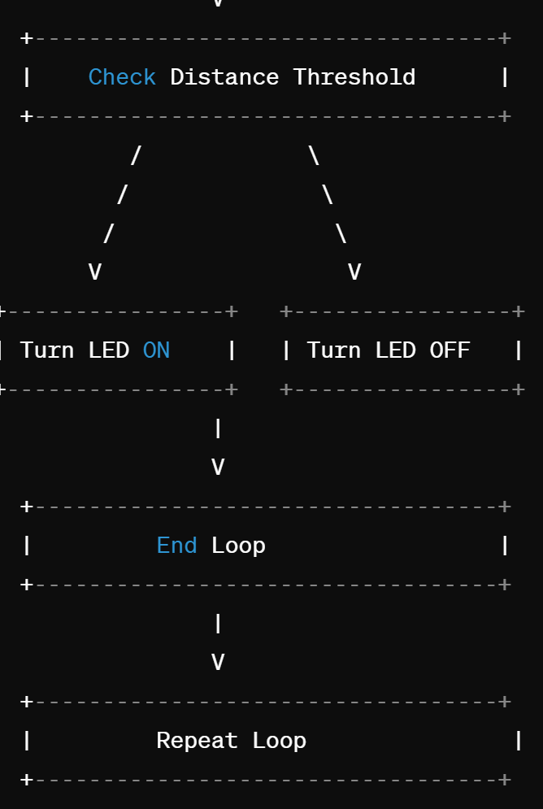
Flow chart

Slide 15
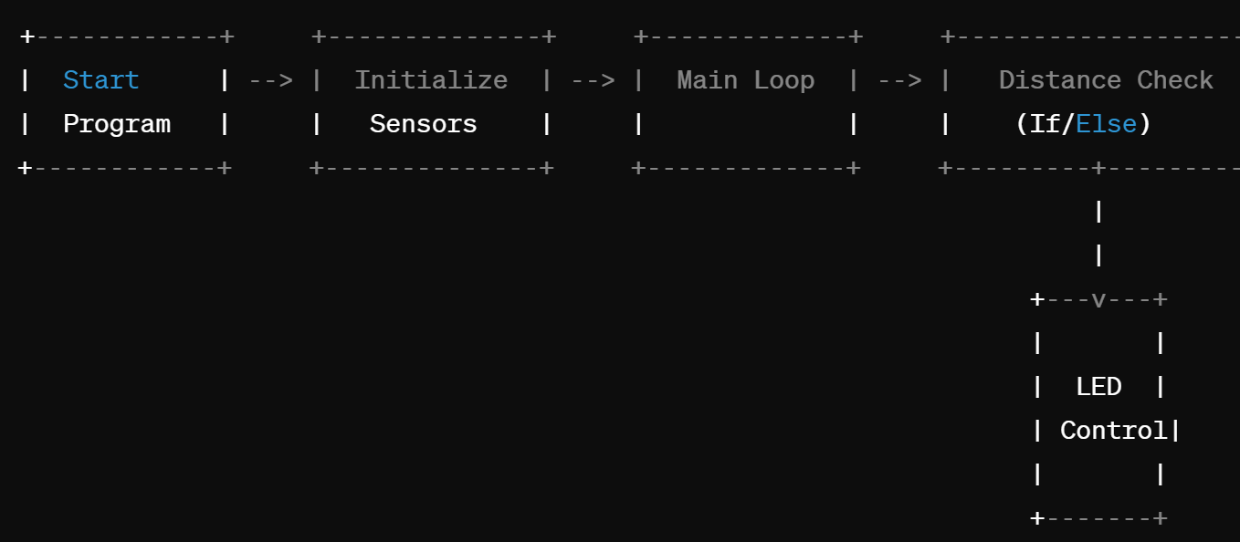
Logic Diagram

Slide 16
Module 2: Automatic lid opening
Components used:
Servo motor:
Ultrasonic sensor
Specifications:
-Servo motor:
Torque rating: 20 oz-in
Speed rating: 0.1s to 0.2s per 60° rotation
Temperature range: 0°C to 50°C
Resolution:1° to 2° per pulse

Slide 17
-Ultrasonic Sensor:
2 cm to long-range 4 m detection and ranging
Level output: high-5V
Static current: < 2mA
Frequency: 40 KHz
High-density and Small blind distance
Temperature range: -20°C to 70°C

Slide 18
Actuator: Servo motor
Motor: The motor is responsible for converting electrical energy into mechanical energy, which produces the desired motion.
Control Circuitry: The control circuitry governs the operation of the servo motor.
Feedback System: Servo motors are equipped with a feedback system that provides information about the motor's current position and speed.

Slide 19
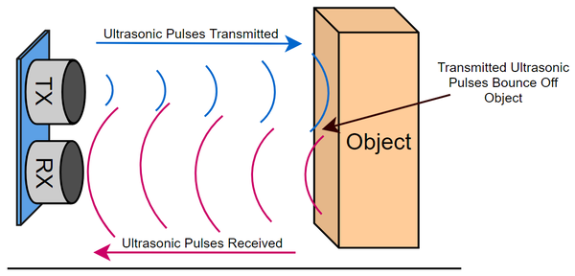
Working Principle: Ultrasonic Sensor
Ultrasonic sensors operate by emitting high-frequency sound waves from a transmitter, which then bounce off objects and return to a receiver. By measuring the time it takes for these waves to travel to the object and back, the sensor calculates the distance to the object based on the speed of sound in air.

Slide 20
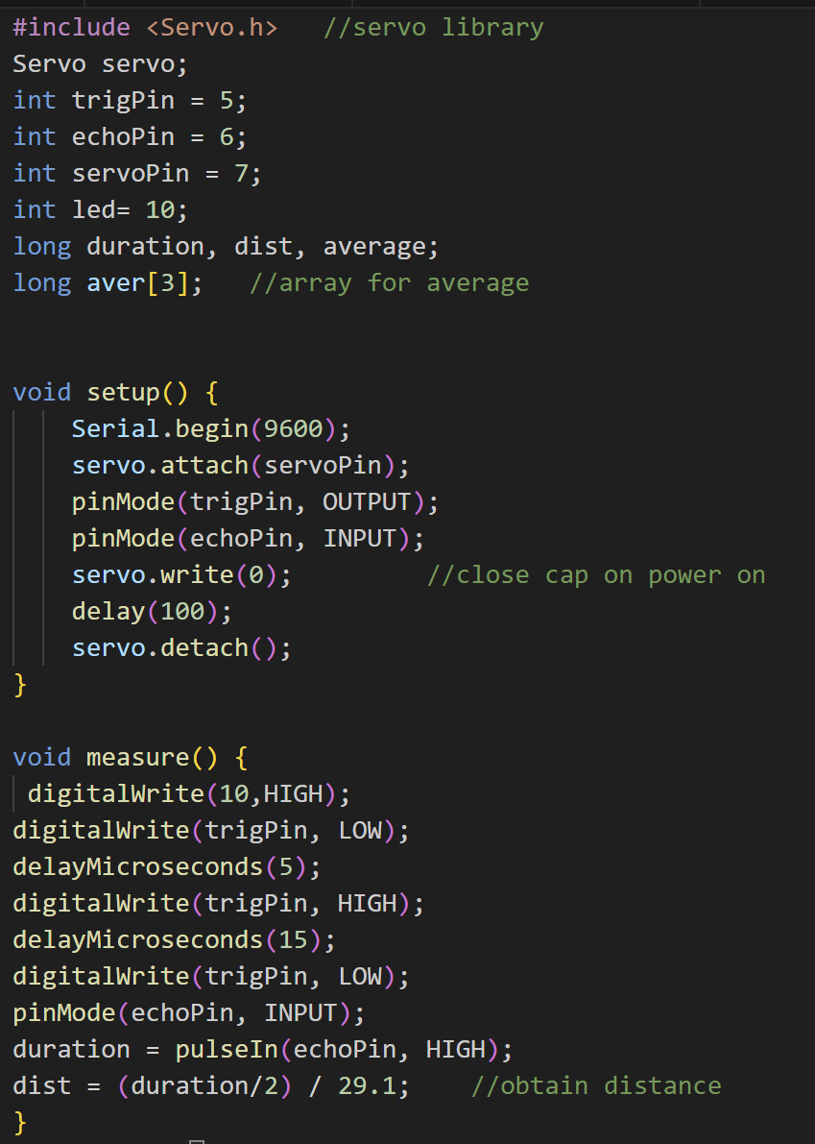
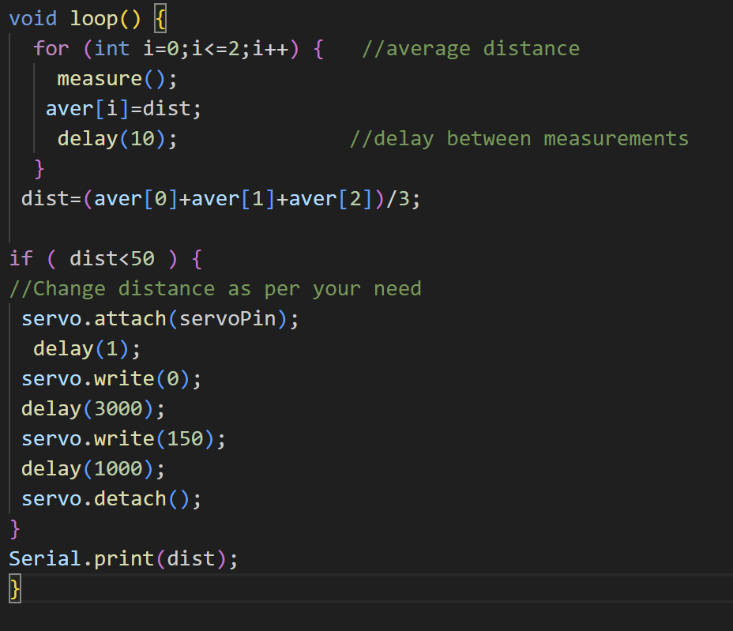
Programming

Slide 21
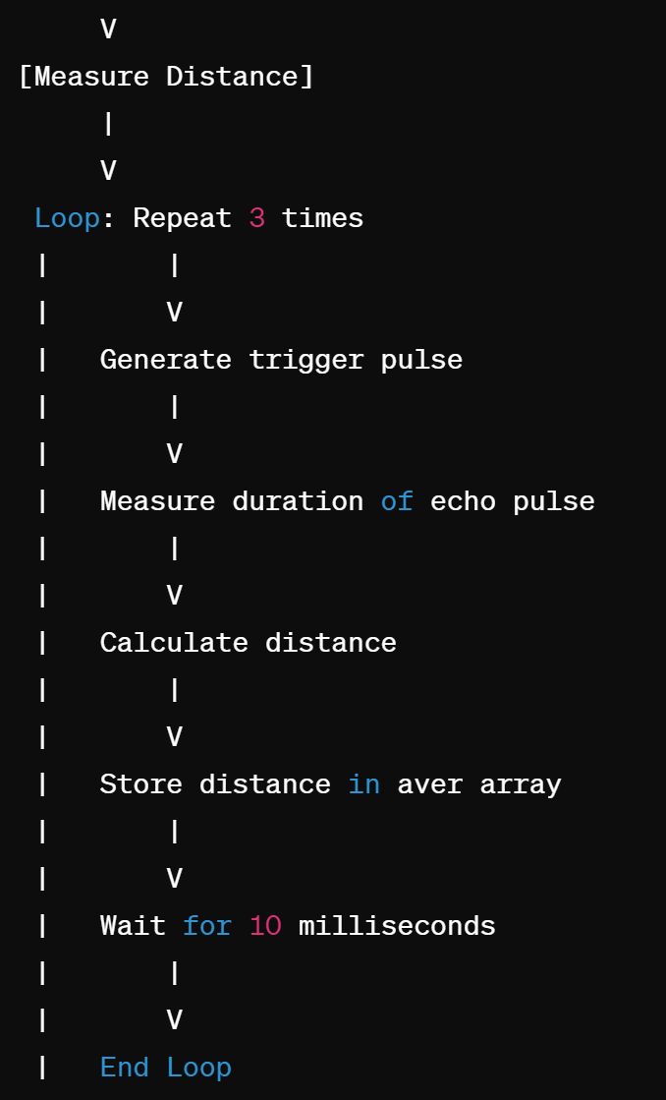
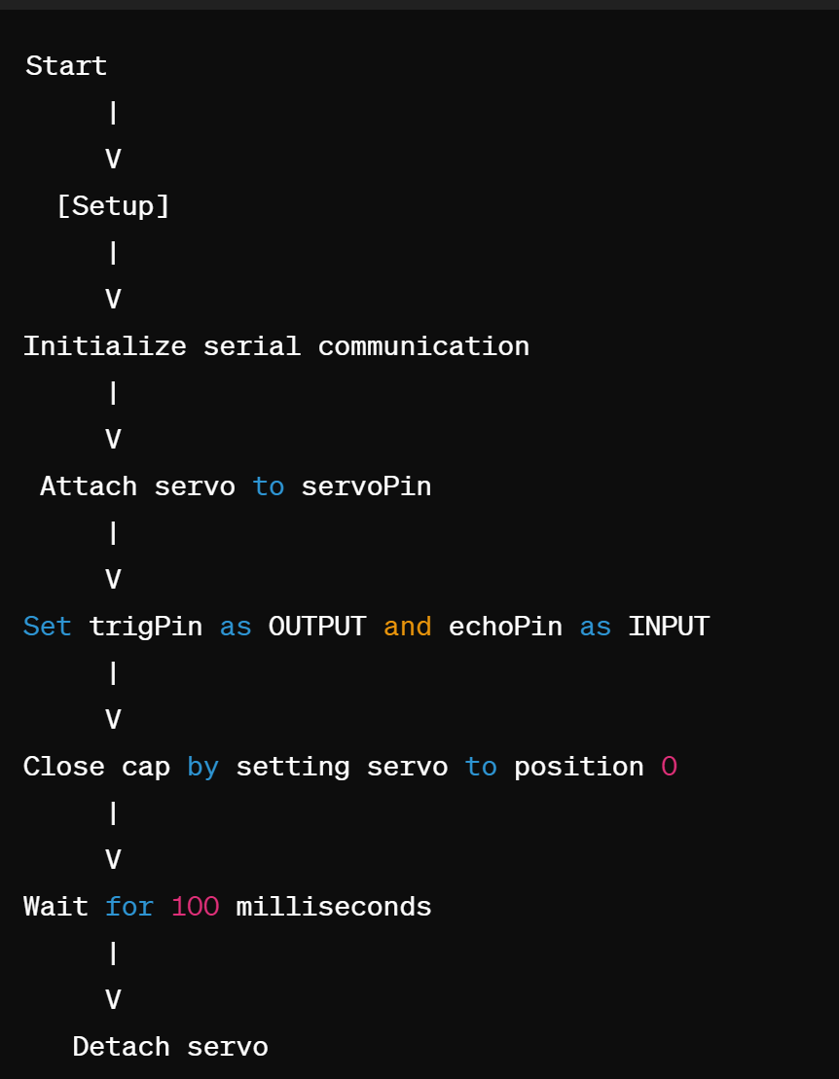
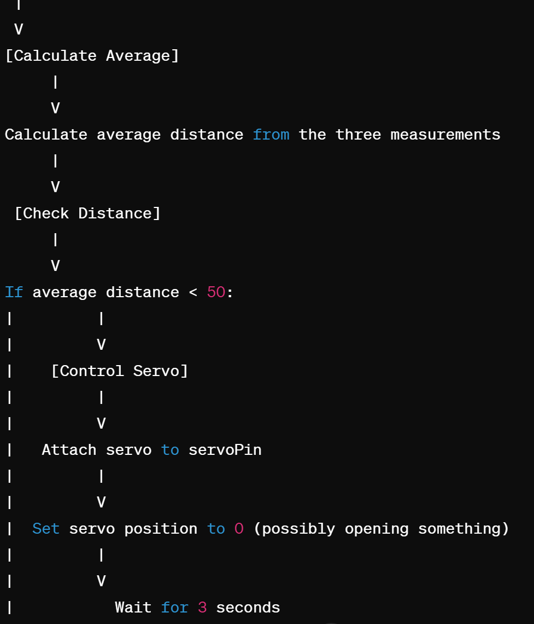
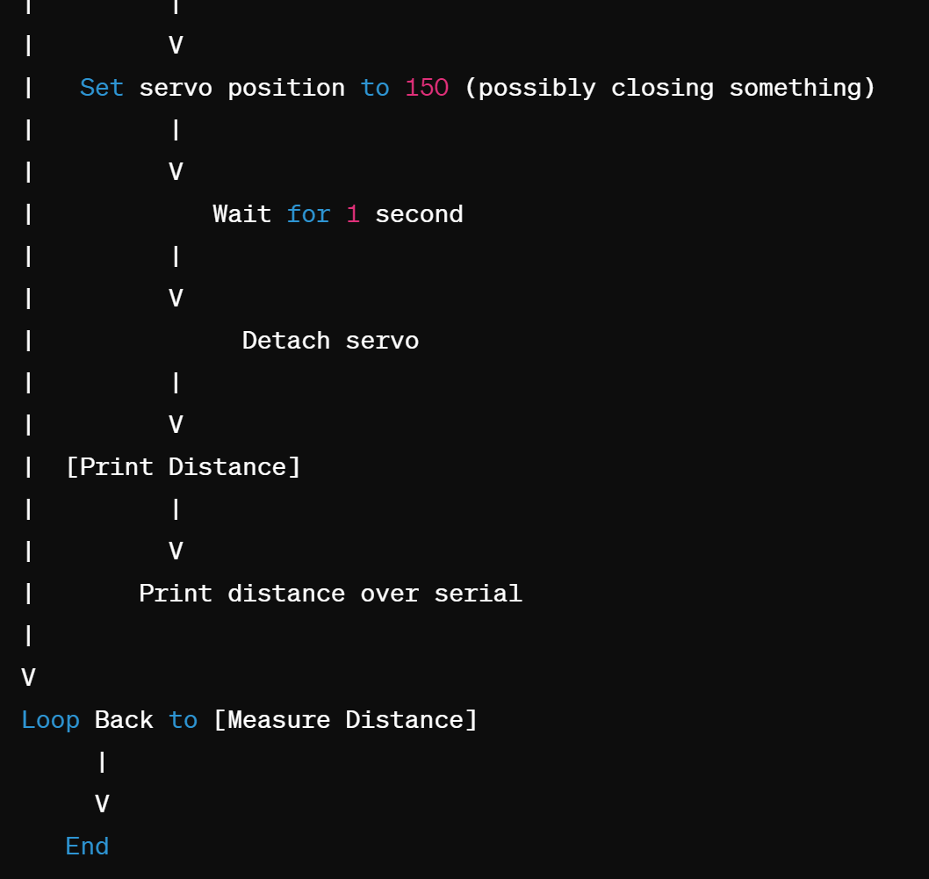
Flow chart

Slide 22
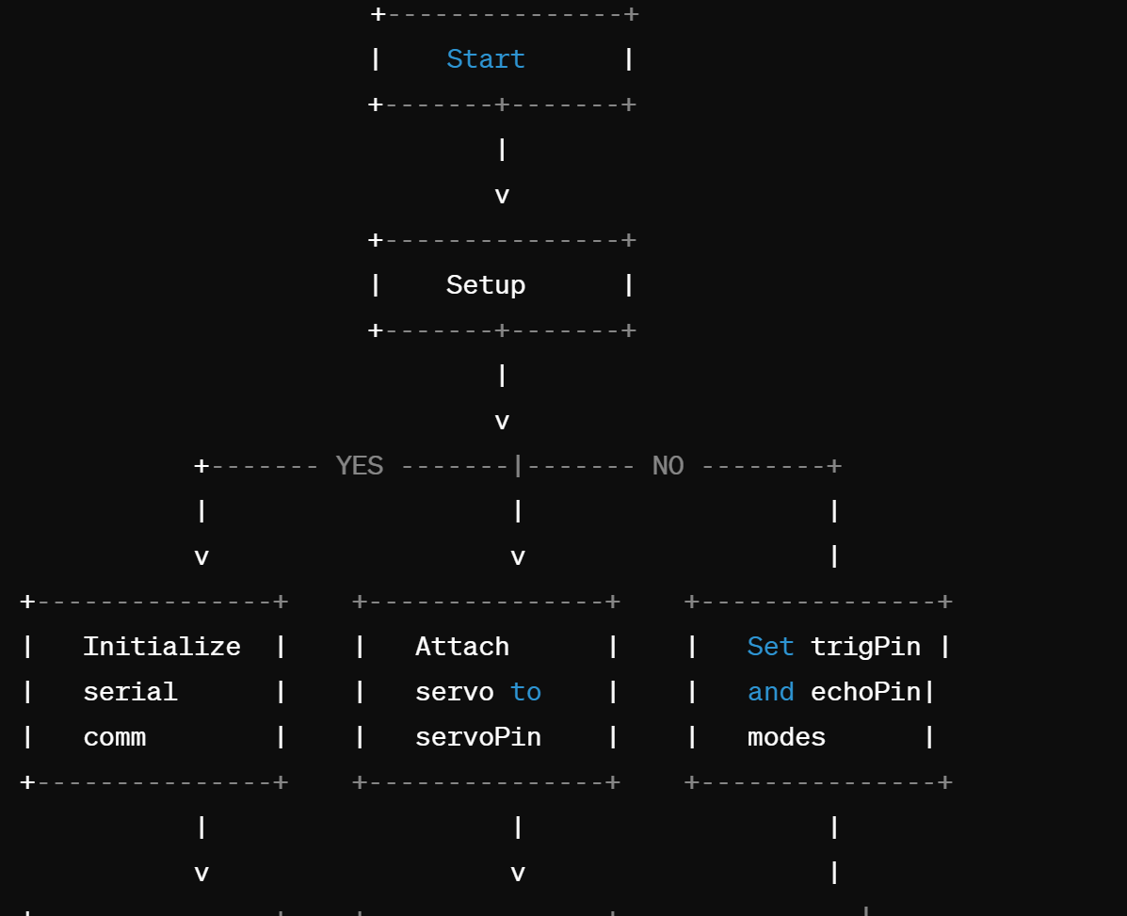
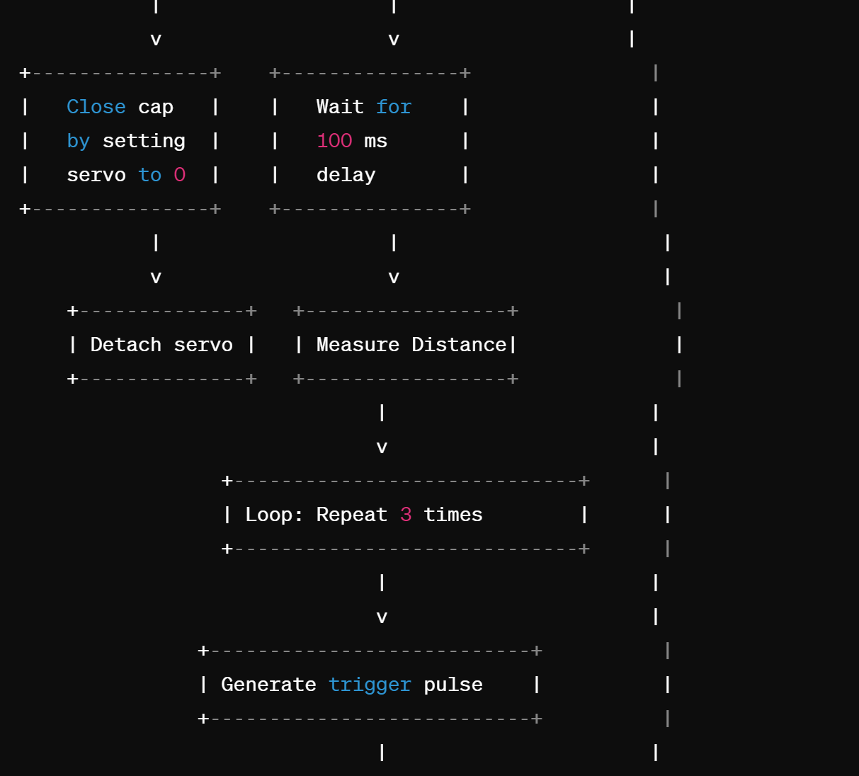
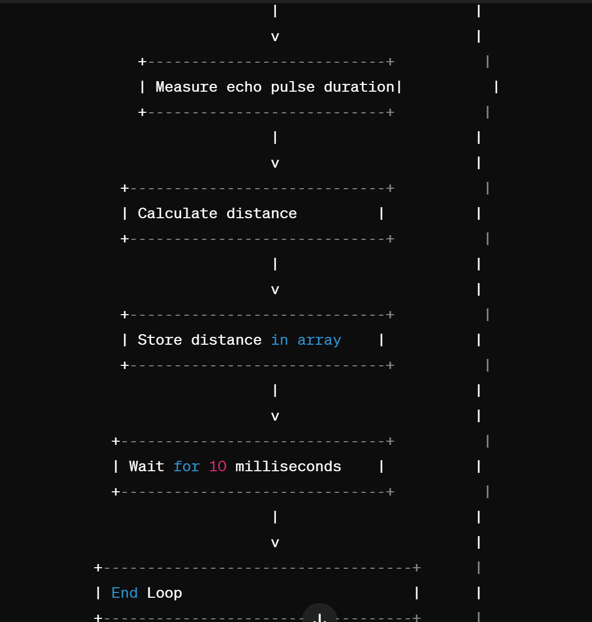
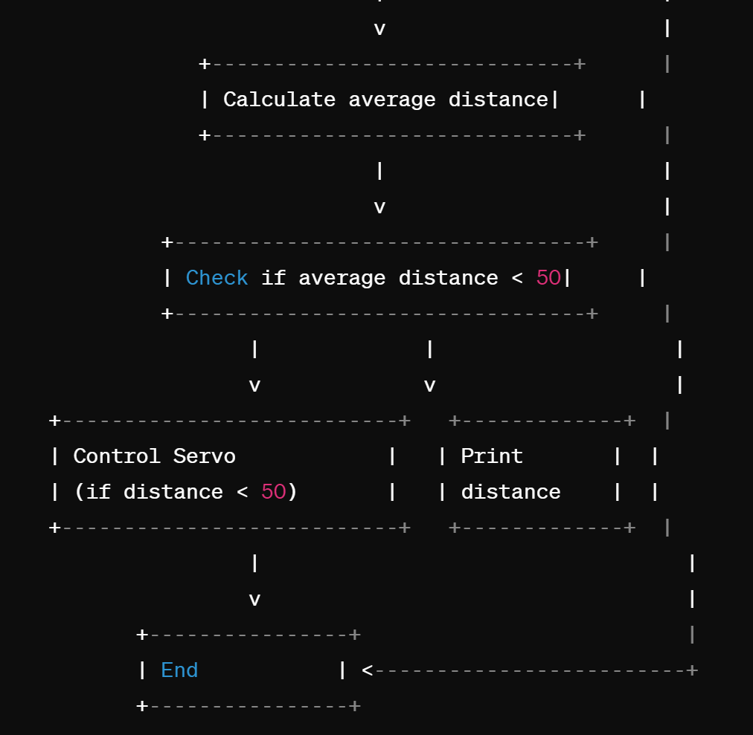
Logic Diagram

Slide 23
Module 3: Nearby waste detection
Components used:
Load Cell Sensor
Load Cell Amplifier
Buzzer

Slide 24
Sensor Specifications:
- Load Cell Sensor:
Two selectable differential input channels.
On-chip active low noise PGA with selectable gain of 32, 64, and 128.
Operating supply voltage range: 2.6 ~ 5.5V.
Operating Temperature Range: -20°C to +85°C.

Slide 25
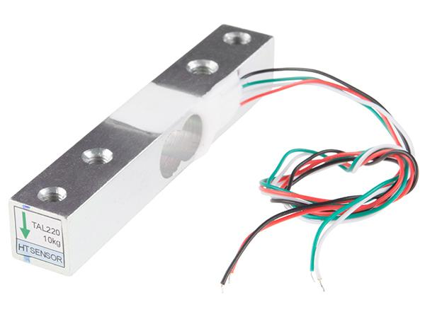
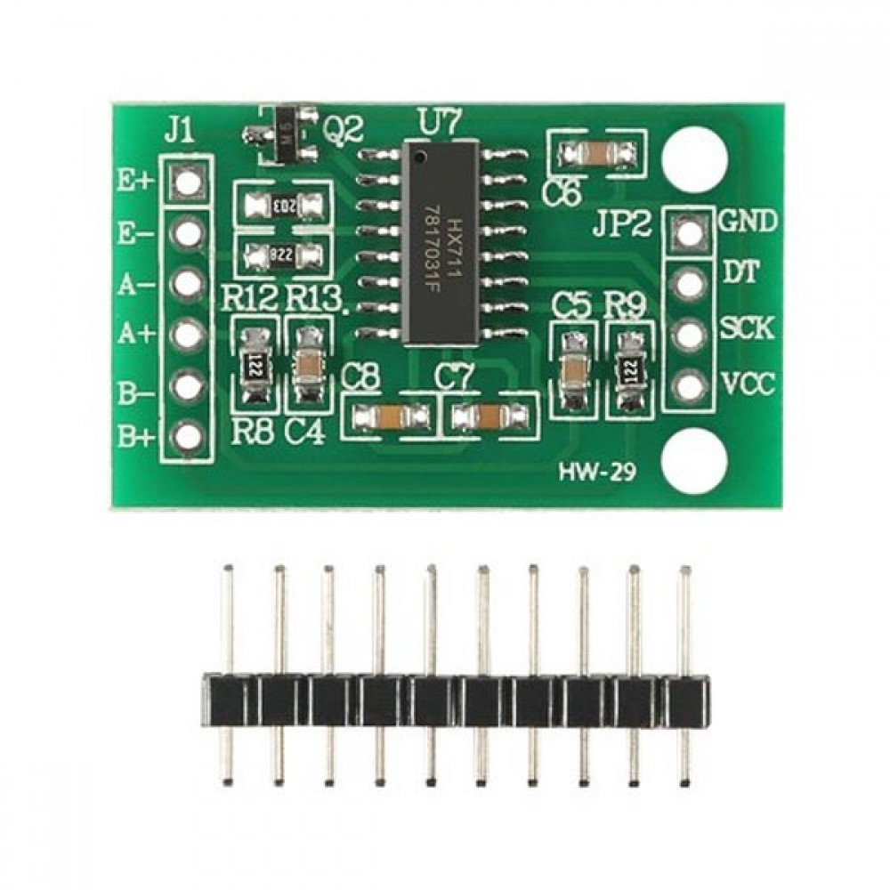
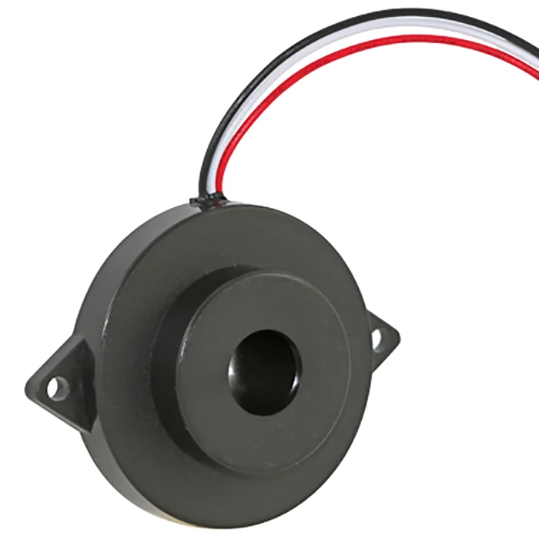

Slide 26
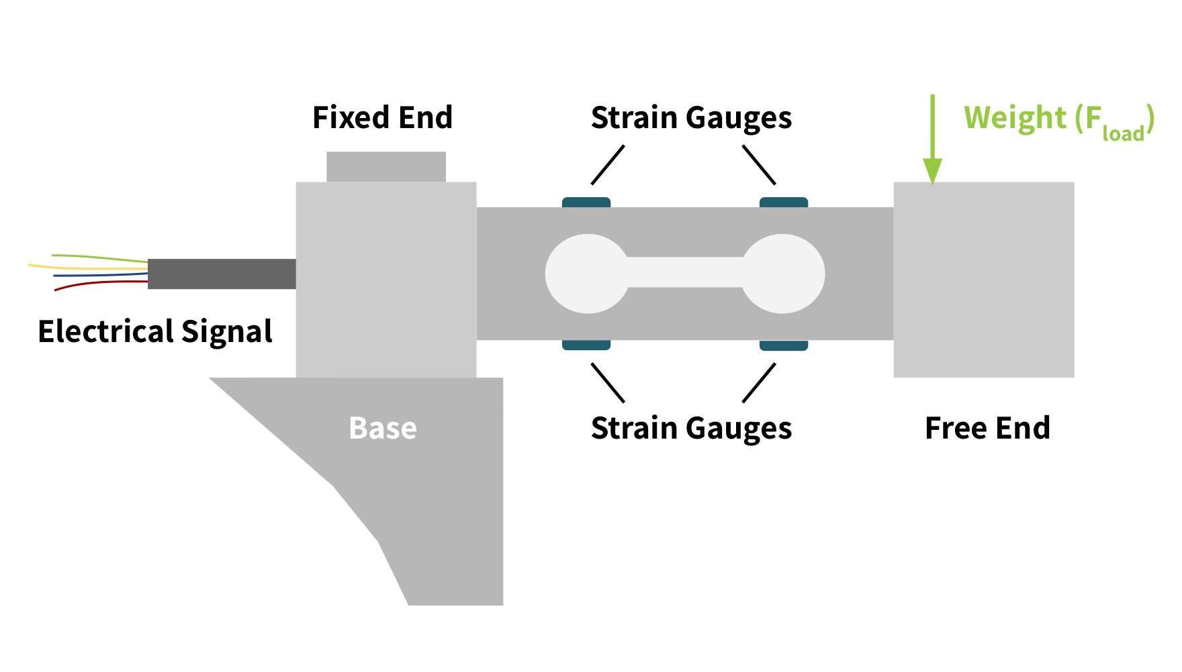
Working Principle
Load cells are transducers that convert force or weight into an electrical signal.
Load cells operate based on the principle of strain gauges. When a force is applied to the load cell, it deforms slightly, causing a change in the resistance of the strain gauges bonded to the load cell. This change in resistance is directly proportional to the applied force, according to the piezoresistive effect.

Slide 27
Functionality
A strain gauge load cell sensor converts mechanical force or weight into an electrical signal.
When force is applied, strain gauges change resistance, creating an imbalance in the Wheatstone bridge circuit.
This generates a small electrical signal, which is amplified and conditioned for measurement.
Calibration ensures accuracy. Used in weighing scales, material testing, automation, and structural monitoring.

Slide 28
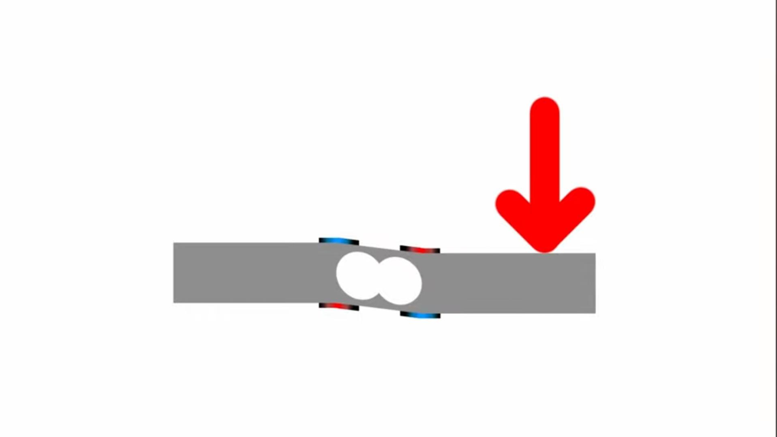
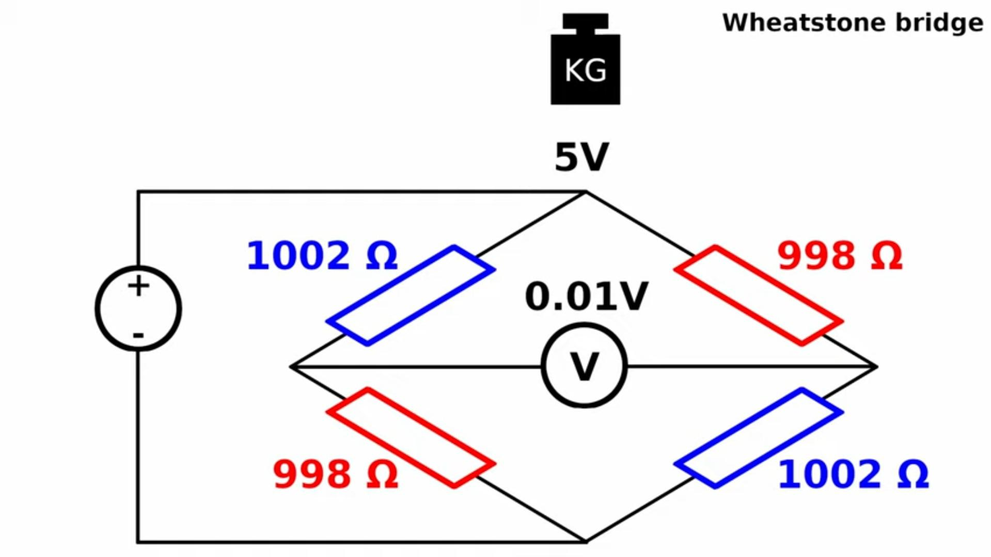
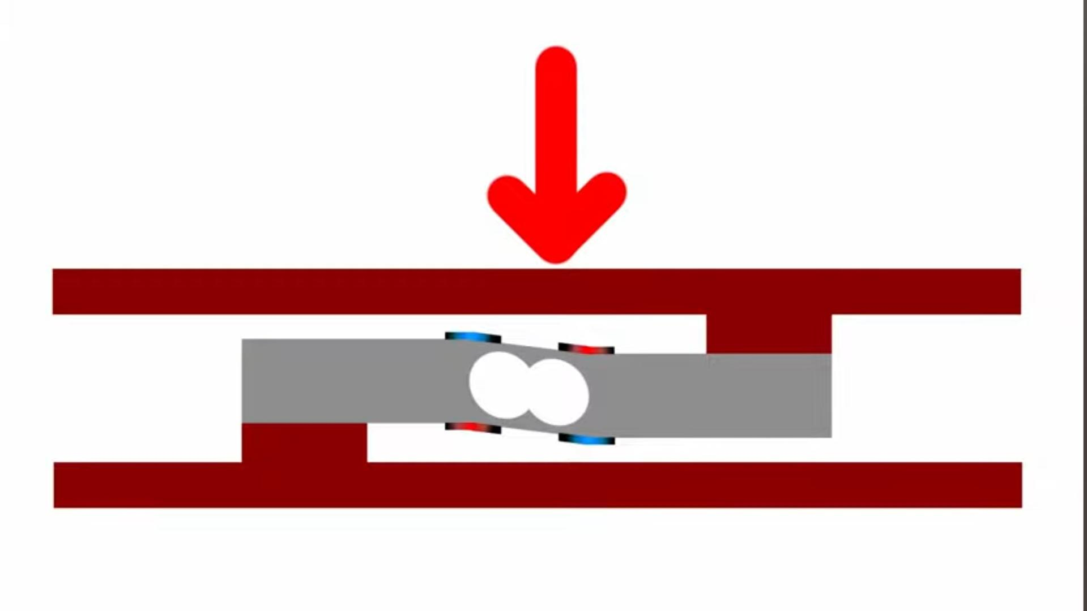

Slide 29
Input
Load Cell Sensor
Load Cell Amplifier
ADC
Calibration
Weight Calculation
Output
Load Cell Sensor: This is the physical sensor that converts applied weight into a small voltage signal.
Load Cell Amplifier: This amplifies the weak voltage signal from the load cell sensor to a level suitable for analog-to-digital conversion.
Analog-to-Digital Conversion (ADC): This converts the amplified voltage signal from the load cell amplifier into a digital value.

Slide 30
Calibration: The software process of converting the digital value from the ADC into meaningful weight units.
Weight Calculation: Any necessary calculations on the calibrated weight data.
Output: Through buzzer we are checking if there is any waste nearby dustbin.

Slide 31
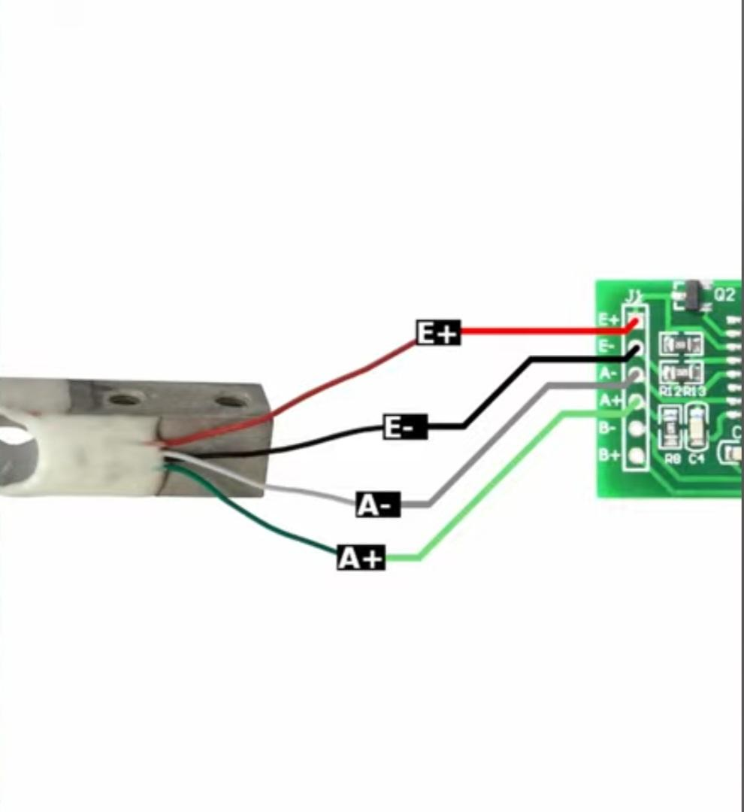
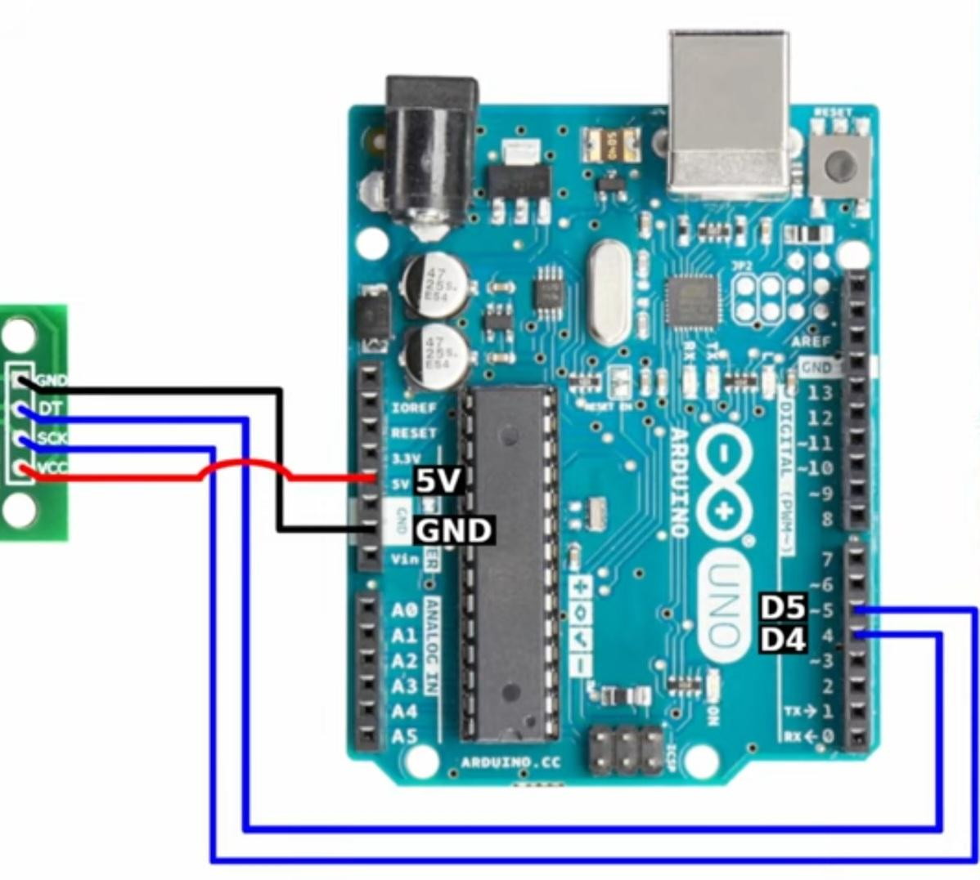
Connections :

Slide 32
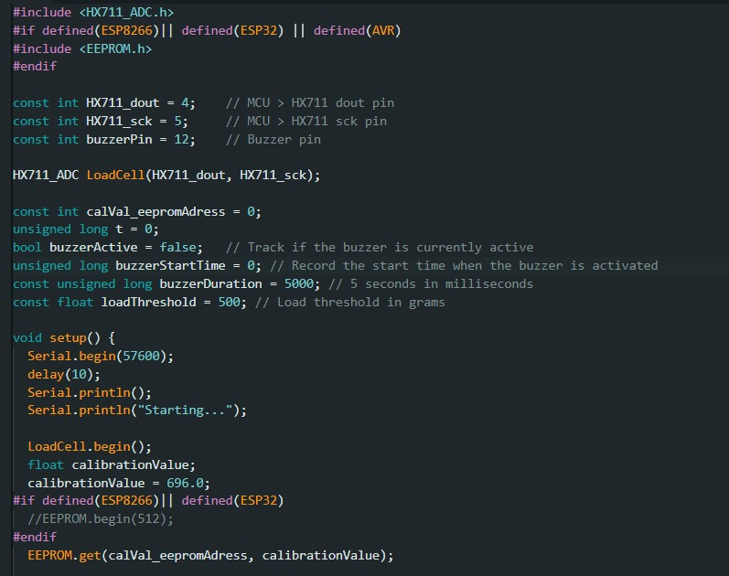
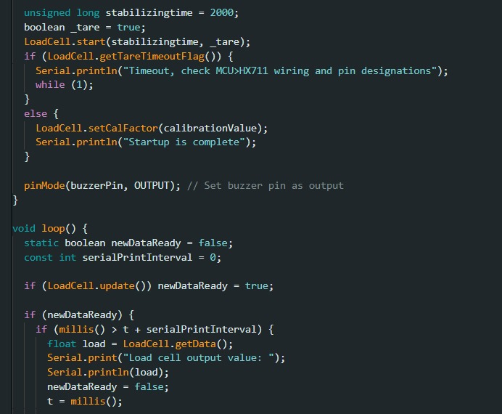
Programming :

Slide 33
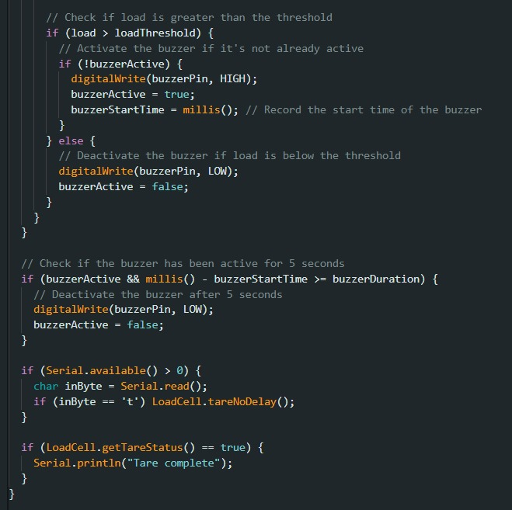

Slide 34
Libraries:
HX711_ADC.h: It provides functions to initialize the HX711, read data from the load cell sensor, and perform calibration.
EEPROM.h:In this code, it is used to store and retrieve calibration values for the HX711.

Slide 35
Program Flow Chart :
+-------------------------------------------------------+
|Setup |
|-------------------------------------------------------|
||
| +-----------------------------------------------+ |
| |Initialize Serial Communication| |
| +-----------------------------------------------+ |
| |Initialize HX711_ADC Library| |
| |Initialize Load Cell Sensor| |
| |Set Calibration Value| |
| |Start Sensor with Stabilizing Time| |
| |Check for Tare Timeout| |
| | Set Calibration Factor| |
| |Set Buzzer Pin as Output| |
| +-----------------------------------------------+ |
||
+-------------------------------------------------------+
|
v
+-------------------------------------------------------+
|Loop|
|-------------------------------------------------------|
||
| +-----------------------------------------------+ |
| |Check for New Data from Load Cell Sensor| |
| +-----------------------------------------------+ |
| |If New Data Available:| |
||||
| | +-----------------------------------+ | |
| | |Print Load Cell Data| | |
| | +-----------------------------------+ | |
| | |Check Load Against Threshold| | |
| | +-----------------------------------+ | |
| | |Activate/Deactivate Buzzer| | |
| | +-----------------------------------+ | |
| | |Check Buzzer Active Time| | |
| | +-----------------------------------+ | |
| | |Check Serial Input for Task| | |
| | +-----------------------------------+ | |
| +-----------------------------------------------+ |
| |
+-------------------------------------------------------+
|
v

Slide 36
+-------------------------------------------------------+
|Buzzer Active Time|
|-------------------------------------------------------|
||
| +-----------------------------------------------+ |
| |Check if Buzzer Active Time Reached| | ||
| +-----------------------------------------------+ |
| |If Yes:| |
||||
| | +-------------------------------+ | |
| | |Deactivate Buzzer| | |
| | +-------------------------------+ | |
| +-----------------------------------------------+ |
| |
+-------------------------------------------------------+

Slide 37
Logic Diagram :
+---------------------+
|New Data| +----------+----------+
|
v
+-----------+-------------+
|Update Load|
|Cell Data|
+-----------+-------------+
|
v
+-----------+-------------+
|Print Load Cell Data|
+-----------+-------------+
|
v
+------------+------------+
|Load > Threshold?|
+------------+------------+
|
v +-----------+-------------+
|Yes|
|Activate Buzzer| +-----------+-------------+
|
v +-----------+-------------+
|No|
|Deactivate Buzzer| +-----------+-------------+
|
v
+------------------+------------+
|Buzzer Active for 5s ?|
+------------------+------------+
|
+------------------+------------+
|Yes|
|Deactivate Buzzer| +------------------+------------+
|
v
+------------------+------------+
|Serial Input?|
+------------------+------------+
|
+------------------+------------+
|Yes|
|Perform Task|

Slide 38
+------------------+
|Load > Threshold?|
+------------------+
|
+------------------+
|Yes|
|Activate|
|Buzzer|
+------------------+
|
+------------------+
|Load < Threshold?|
+------------------+
|
+------------------+
|Yes|
|Deactivate|
|Buzzer|
+------------------+

Slide 39
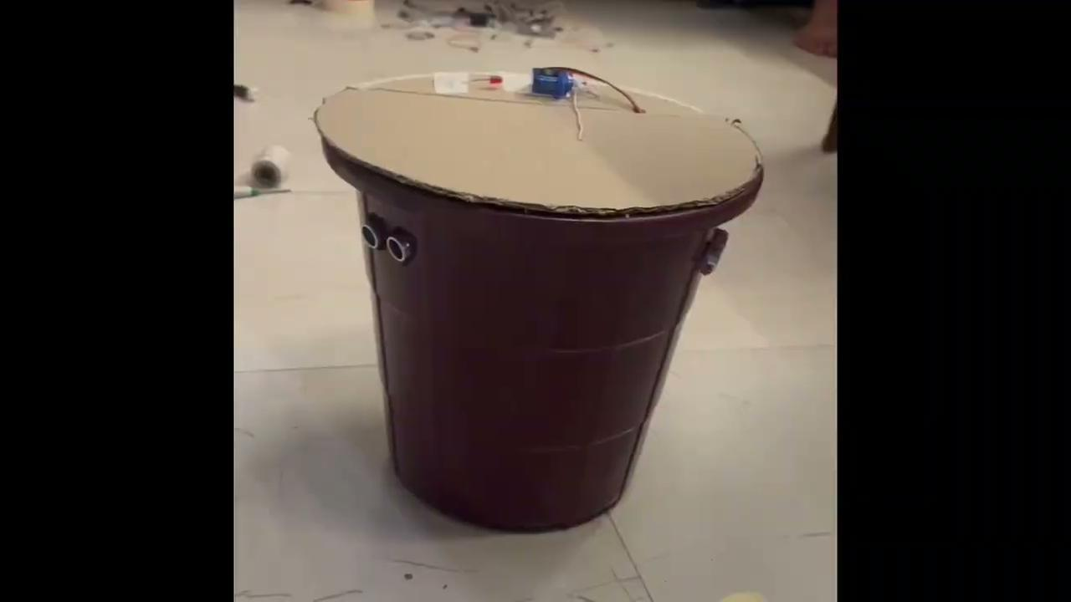
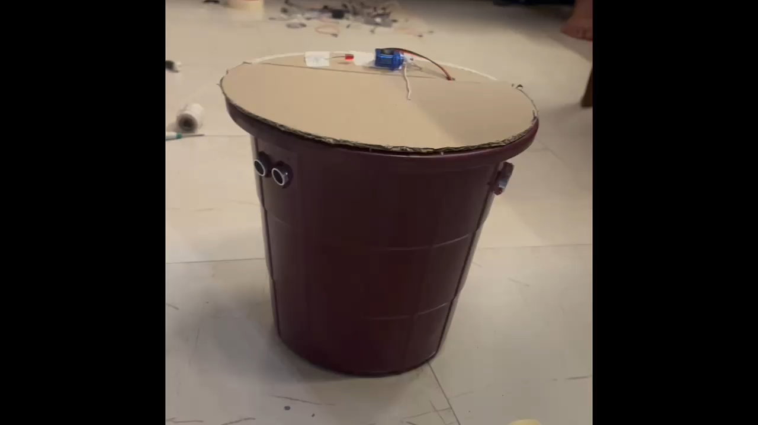
Testing and demonstration of working model

Slide 40
Drive link of video: https://drive.google.com/file/d/1XfxRNXFbHhCb86OnIb7N6elEqmI3VtJW/view?usp=drive_link

Slide 41
Result:
Prototype Performance Evaluation:
The Automatic Dustbin prototype demonstrated exceptional performance during real-world testing.
Accuracy of sensor detection:
The sensors accurately detected objects within their specified range, minimizing false positives and ensuring reliable operation.
Reliability of the lid-opening mechanism:
The lid-opening mechanism proved robust and reliable, withstanding repeated use without degradation in performance.

Slide 42
Waste level detection:
The dustbin effectively detected changes in waste levels using ultrasonic sensors, providing timely alerts when nearing full capacity.
Comparison with Traditional Dustbins:
Compared to traditional dustbins, the Automatic Dustbin offered significant advantages in terms of hygiene, convenience, and efficiency.
Convenience:
Automatic flap opening and waste level detection enhanced user convenience, eliminating the need for manual lid operation and providing timely alerts when the bin required emptying.

Slide 43
Challenges:
Challenges encountered during development included fine-tuning sensor sensitivity to optimize detection accuracy while minimizing false triggers.
Integration of multiple sensors required careful calibration to ensure seamless operation and prevent interference between sensor inputs.
As the project involved implementing automatic flap opening, waste level detection, and nearby waste sensing, each functionality required its own set of code and sensor configurations.
Integrating three distinct sets of code while ensuring compatibility and avoiding conflicts posed a significant hurdle.

Slide 44
The process required careful coordination and troubleshooting to address issues such as code optimization, memory constraints, and sensor calibration.
Despite these challenges, thorough testing and iterative refinement ultimately resulted in successful integration and seamless operation of all functionalities within the Arduino framework.

Slide 45
Future Work:
1. Refinement of Sensor Calibration: Fine-tuning sensor settings to improve accuracy and minimize false triggers.
2. Optimization of Power Consumption: Exploring energy-efficient alternatives like solar panels and implementing power-saving modes.
3. Implementation of Machine Learning Techniques: Using AI to adaptively adjust sensor sensitivity for better performance.
4. Enhancement of User Interface: Improving feedback with LED displays and wireless connectivity for remote monitoring.

